Slide 1
Introduction to Image Analysis with FIJI
4. IJ Macro: Basics
Noreen Walker, Gayathri Nadar
Scientific Computing Facility, MPI-CBG
3.-7.5.2021
Aim of this session:
Learn the basics of IJ Macro language
Application: Write basic IJ macros to do image processing
With material from:
Robert Haase
Benoit Lombardot

Slide 2
Course schedule
Day 1 (Mon 3.5.)
Image basics, visualization, measurements
Spot detection
Segmentation (start)
Day 2 (Tue 4.5.)
Visit LMF
Segmentation (cont’d)
Mathematical background: image filters, morphology
Day 3 (Wed 5.5.)
Advanced segmentation: Machine learning with Ilastik
IJ Macro (start)
Day 4 (Thu 6.5.)
IJ Macro (cont’d)
3D data: visualization and analysis
Day 5 (Fri 7.5.)
Image registration, image stitching
Time sequence analysis and tracking
Good practices

Slide 3
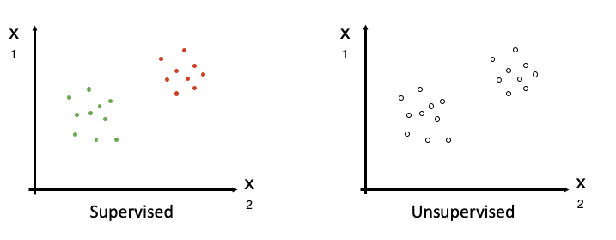
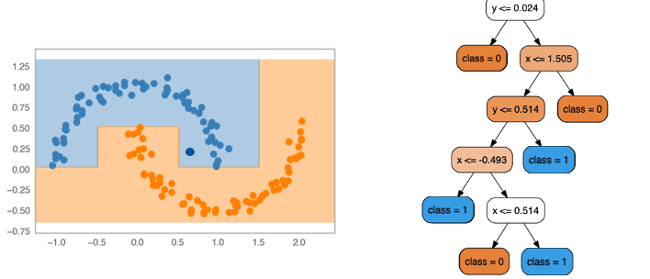
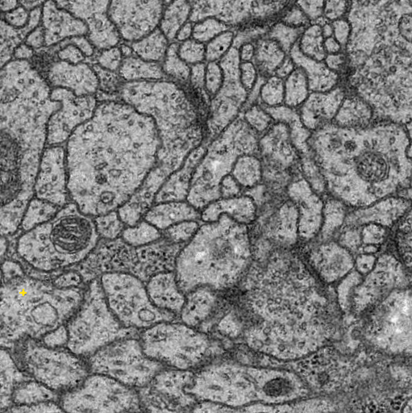
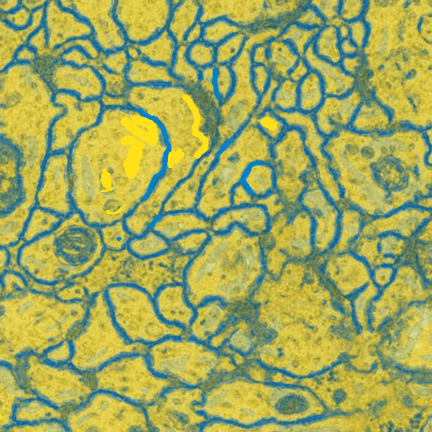
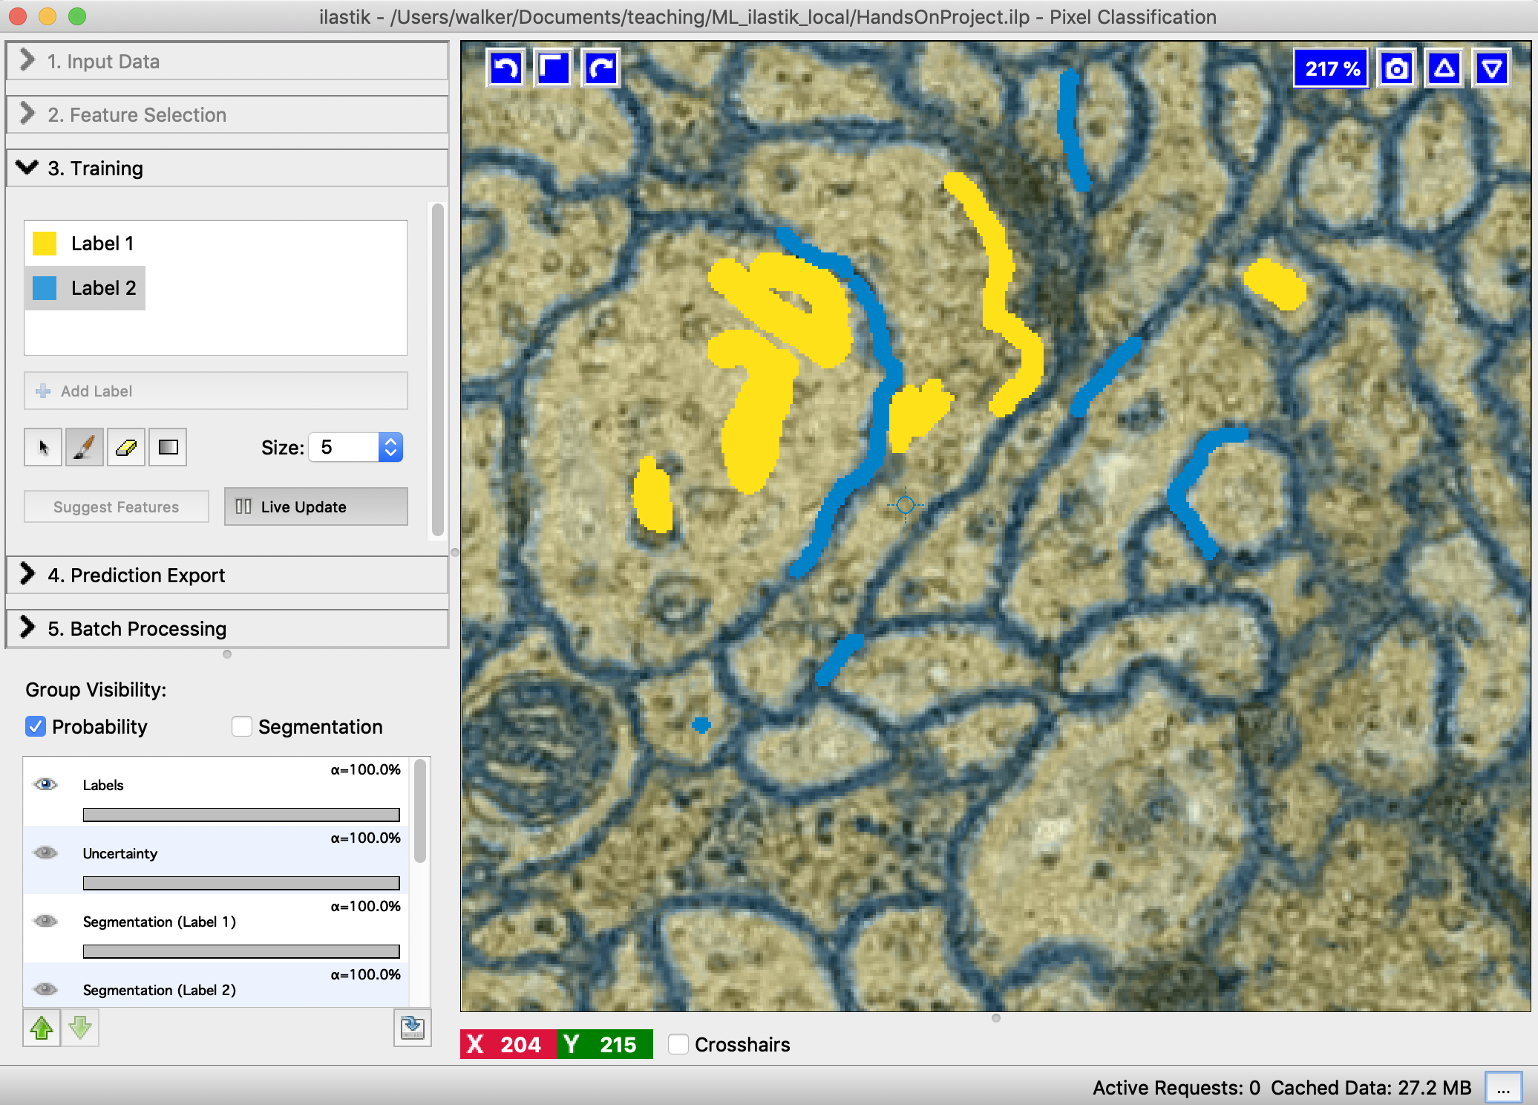
Recap: Machine Learning, Ilastik
Machine learning intro
Supervised vs. unsupervised
Supervised: Decision tree and random forest
Segmentation as pixel classification
Ilastik
… with supervised learning

Slide 4
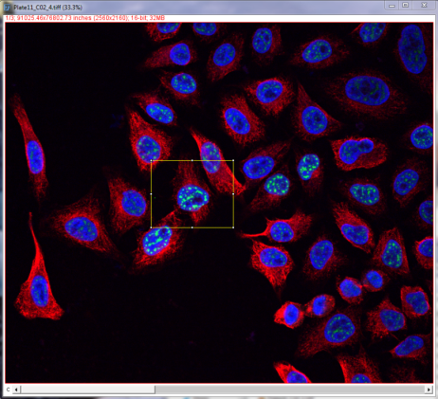
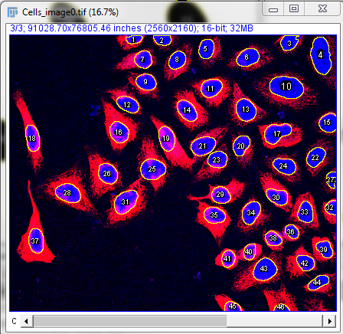
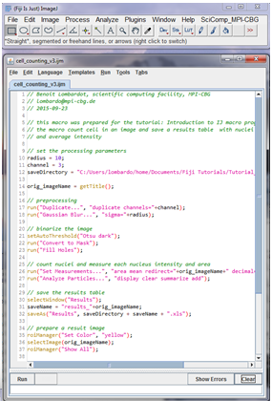
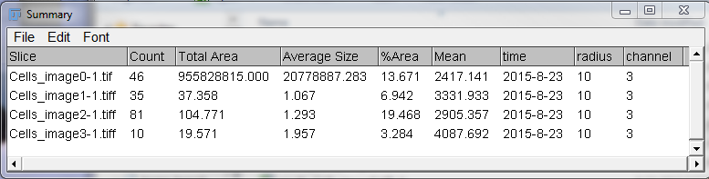
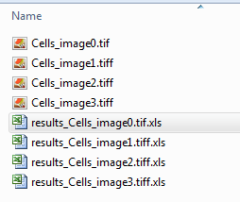
Today’s Goal
Implement reproducible analysis with a macro

Slide 5
Overview
Introduction to IJ Macros
Macro language basics
Macro Recorder
Troubleshooting
Working with open images
Macro language advanced: Loops
Customizing a macro
Good practices for reproducible results

Slide 6
Poll
What is your experience with IJ macros?
Opened and ran a macro
1
Edited an existing macro to suit my needs
2
Wrote a macro from scratch
3
I don’t know what is a macro
4

Slide 7
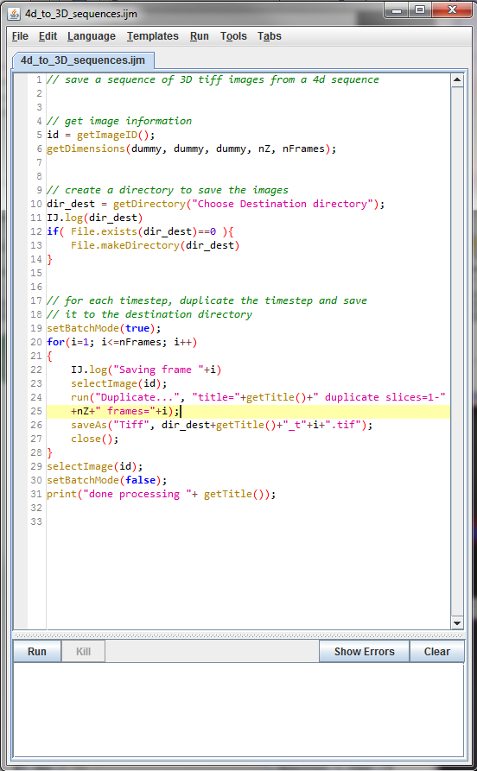
Introduction to IJ Macro

Slide 8
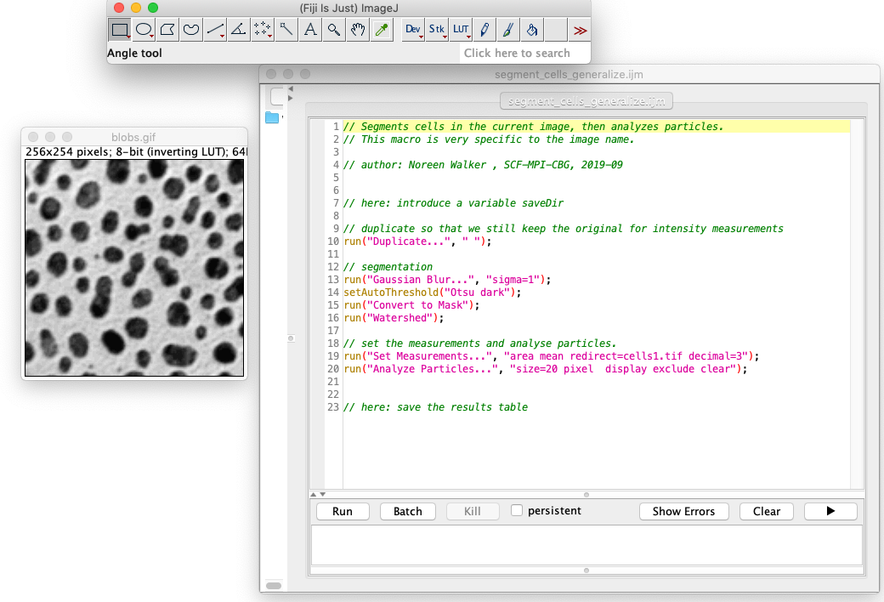
IJ Macros
Why would we want to write an IJ Macro?
Automate a repetitive task: analyse many images.
Make the analysis reproducible.
A means to document what you did.
Share the workflow with colleagues.

Slide 9
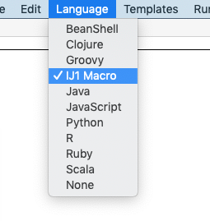
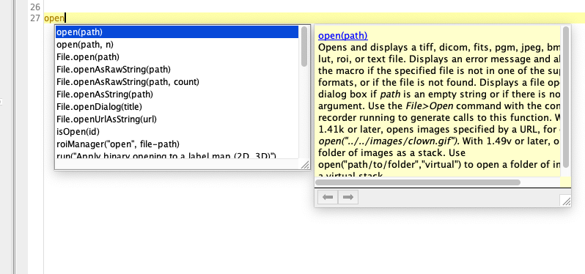
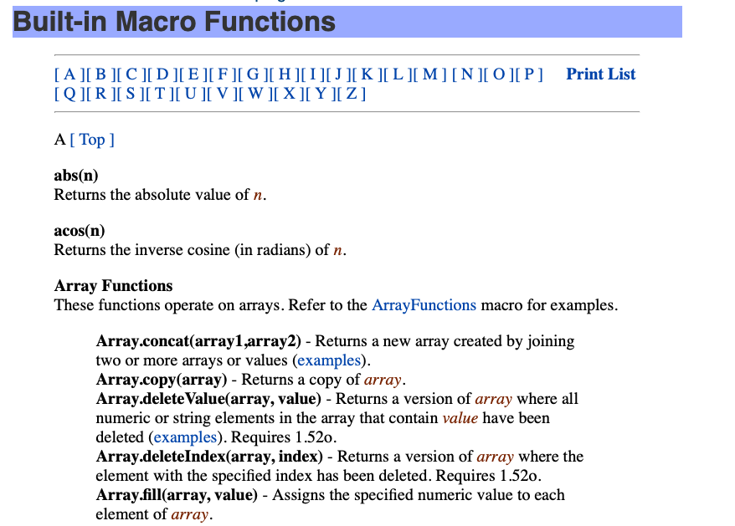
IJ Macros
Why choose Macro as programming language?
Macro is one of several programming languages in Fiji/ImageJ.
It is a simple programming language.
Good to get started.
It has the best user-experience:
Autocomplete: game changer when writing code.
Documentation exists.
Macro recorder works well.

Slide 10
Syntax
Grammar of any programming language
Each language has some “rules” on how to write commands
Language | Command
IJ Macro | number = 10;
Python | number = 10
C++ | int number = 10;
Slide adapted from: BOMP, University of Melbourne

Slide 11
Syntax in IJ Macro Language
All commands must end with Semicolon “ ; “
This tells ImageJ, that the assignment is complete, the end of line is reached
Case sensitive
number = 10;
print(number);
}
number = 10;
Number = 10;
number = ”five";
number = ”Five";
Are all different!
Slide adapted from: BOMP, University of Melbourne

Slide 12
IJ Macros Elements
A macro has the following elements:
Variables
Values (numbers, vectors, texts)
Comments
They document the process
but are ignored at execution
Commands
Perform tasks.
Are functions.
Loops, conditions, custom functions
… and more

Slide 13
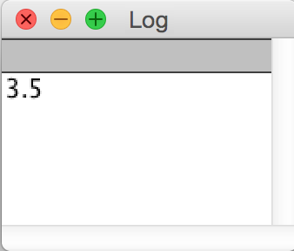
Variables
Variables hold values. Could be numbers or strings or arrays.
Name
Value
myVariable
”area"
1
// initialise program
a = 1;
b = 2.5;
// run complicated algorithm
final_result = a + b;
// print the result
print( final_result );
variables.ijm
Slide adapted from: BOMP, University of Melbourne

Slide 14
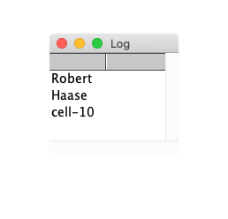
Strings
Texts are called “strings” in the world of programming
They represent a chain of characters
Text should always be inside double quotes
”hello world” ”cell-1” ”5” ”Volume of Sphere="
// initialise program
firstname = "Robert";
lastname = "Haase";
cellname = ”cell-10";
// show results
print(firstname);
print(lastname);
print(cellname);
string_variables.ijm

Slide 15
Numbers
Number is detected as “integer” or “float” type.
Integer: numbers without fraction
1 1252 -35
Float: numbers which includes a fraction represented in decimal format
1.685 3.1485 0.4
// initialise program
a = 1; // integer
b = 2.5; // float
// run complicated algorithm
final_result = a + b;
// print the result
print( final_result );
Can you guess the number type of the final_result?
variables.ijm
Slide adapted from: BOMP, University of Melbourne
Notes:
Its float

Slide 16
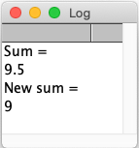
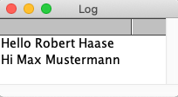
Operators
Variables can be connected using operators such as “ +, -, <, > ”
The operator “ = ” is used to assign a value to a variable.
The operator “ + ”
For numbers: add
For strings: concatenate
// assign values using “=“ cell_number = 1;
cell_name = “nuclei”;
n1 = 3;
n2 = 2.5;
n3 = 4;
// can add variables
sum = n2 + n2 + n3;
// can add numbers as well
sum_new = 4 + 5;
operators_add.ijm
firstname = "Robert";
lastname = "Haase";
// “ “ is for space between strings
name = firstname + " " + lastname;
another_name = ”Max " + ”Mustermann";
print(“Hello ” + name);
print(“Hi ” + another_name);
operators_concatenate0.ijm
https://imagej.net/developer/macro/macros.html#operators
Notes:
Show output?

Slide 17
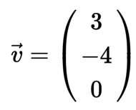
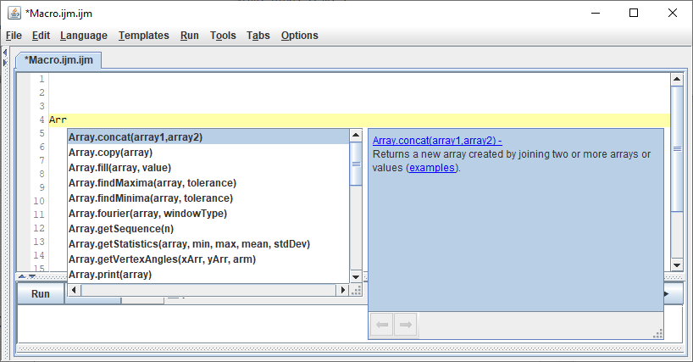
Arrays
v = newArray(3, -4, 0);
animals = newArray("dog", "cat", "mouse");
mixed = newArray(”cell", 2, 8, “nucleus” );
An array represents a vector of values
Inside ()
Elements separated by comma
Could have both strings and numbers
arrays.ijm
v[0] = 3;
v[1] = -4;
print(v[2]);
Elements of the array are accessible like this:
1
Note: The first element is number 0!
2
Arrays can be concatenated:
merged = Array.concat(v, animals);
Find out what else you can do with Arrays by starting typing:

Slide 18
// Comments
Comments should contain additional information such as
User documentation
What does the program do?
How can this program be used?
Your name / institute in case a reader has a question
Comment why things are done.
Do not comment what is written in the code already!
//
// This program sums up two numbers.
//
// Usage:
// * Run it in FIJI (www.fiji.sc)
//
// Author: Robert Haase, MPI CBG,
// rhaase@mpi-cbg.de
// July 2016
// initialise program
a = 1;
b = 2.5;
// run complicated algorithm
final_result = a + b;
// print the final result
print( final_result );
good_comments.ijm
a = 1;
b = 2.5;
sum = a + b;
// sub = a – b ;
/*
a = 1;
b = 2.5;
sum = a + b;
*/
area = 10;
print(area);
Comments can also used to ”comment out” code
Even in blocks

Slide 19
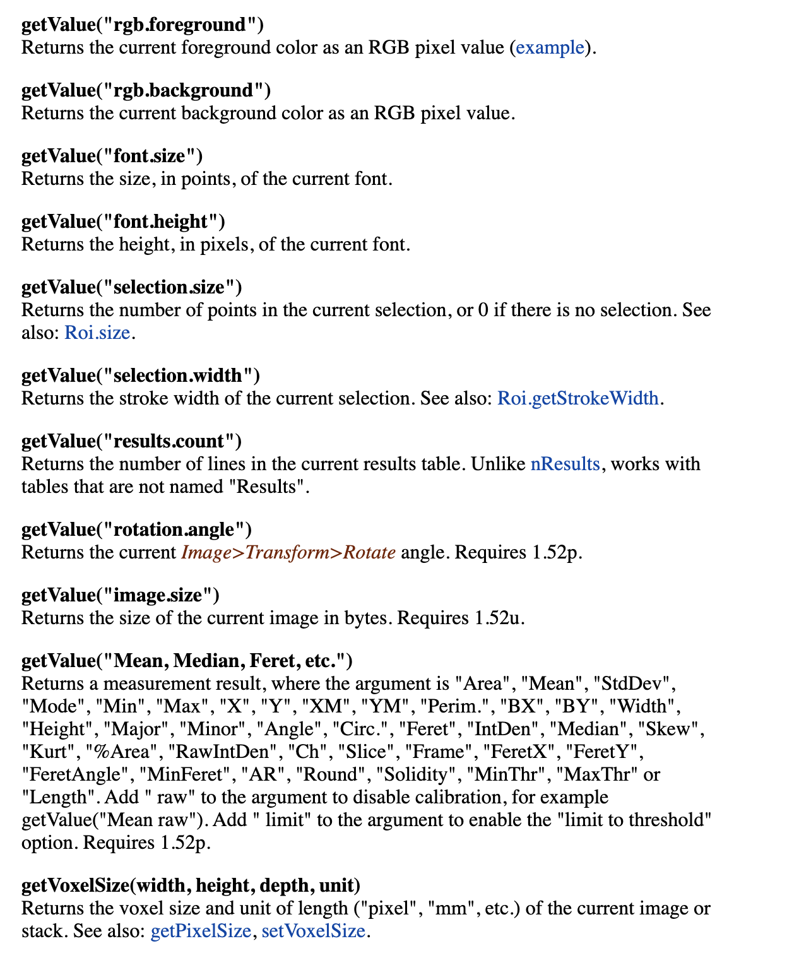
Commands
… perform tasks.
They correspond to a menu entry or belong to “built-in” commands.
Commands can:
Act on images
Duplicate an image, invert an image, …
Return information
getTitle() return the name of the image in focus, …
Use any element of the user interface (toolbar, Roi manager, result tables )
Modify Roi, Add information to a results table, …
Read, Write information to disk
Open image, save table, …
And more.
https://imagej.net/developer/macro/functions.html
Notes:
How to know the existing commands?
2 main sources the macro recorder and macro built-in webpage
+ autocomplete

Slide 20
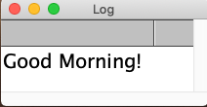
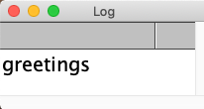
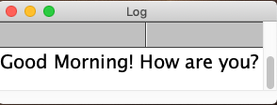
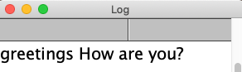
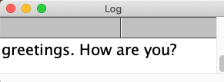
Quiz 1
What will be printed?
greetings = “Good morning!”;
// question 1
print(greetings);
// question 2
print(“greetings”);
Which command prints the following log output?
print(text1);
greetings=“Good morning!”;
text1 = "greetings. How are you?";
text2 = greetings + " How are you?";
text3 = "greetings" + " How are you?";
print(text2);
print(text3);
print(text2);
print(text1);
print(text3);

Slide 21
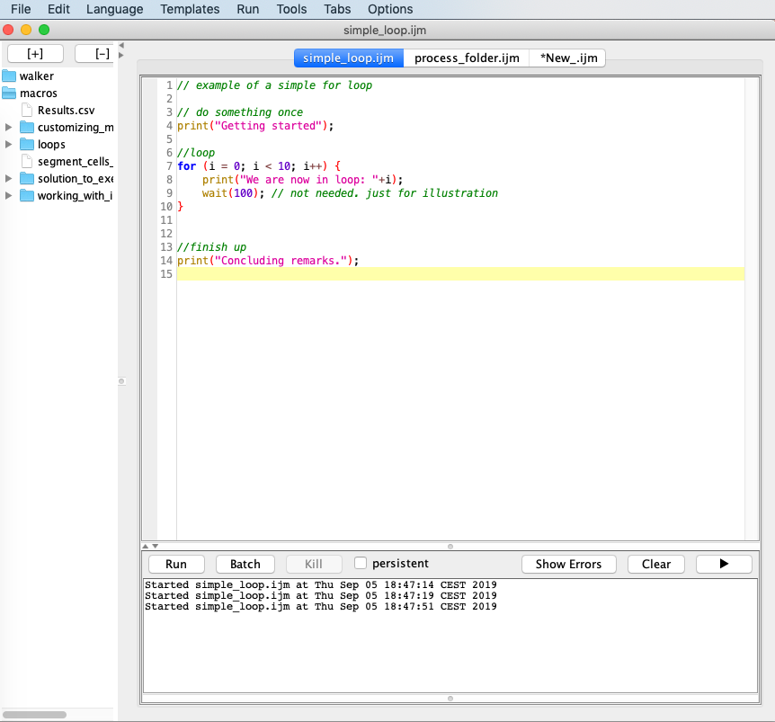
The Script Editor
Macros are written in the script editor.
Write a macro
Run a macro
Find errors and correct them
Start a new macro:
File > New > Script… Shortcut: [
Select the language in the editor: Language > IJ1 Macro
Open an existing macro:
Drag & drop into Fiji status bar.
Or: File > Open…
Press Run to execute the macro.

Slide 22
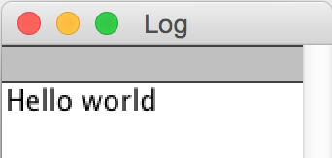
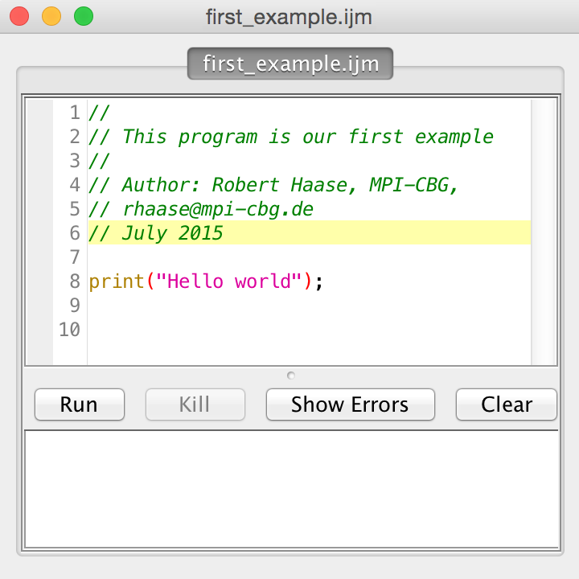
Demo/Hands-on: Language Basics
Exercise 0: Run an existing macro
Open exercise_analyze_blobs.ijm, read what it does (all comments) and run the macro.
Exercise 1: Our first macro
Let’s write our first macro:
Open FIJI,
Click on Menu File > New > Script…
Enter the macro
Save it as first_example.ijm !
Click on Run
Create a variable for your first name and last name and print some greetings.
Solution: solution_first_example.ijm

Slide 23
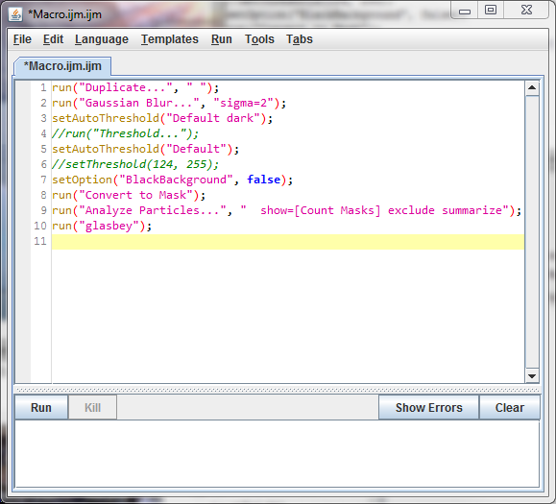
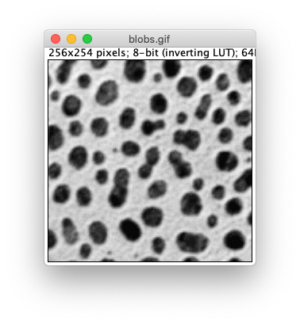
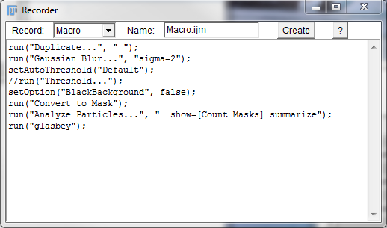
Macro Recorder

Slide 24
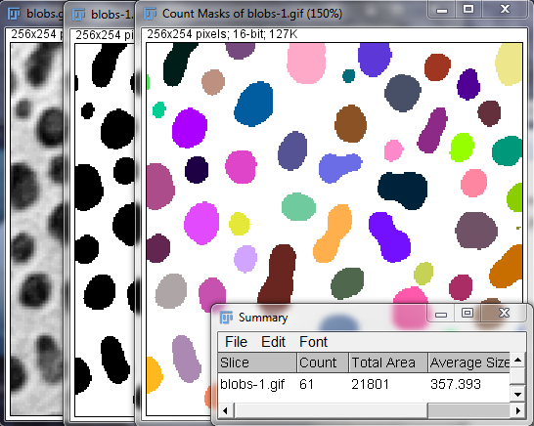
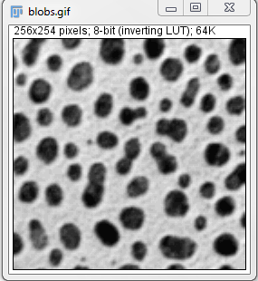
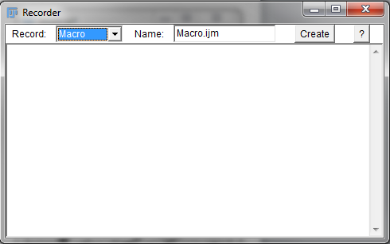
The Macro Recorder
Records the steps you perform on an open image
➔ Menu Plugins>Macro>Record…
Set the language to macro
Perform analysis manually in the interface
Create button opens the script editor

Slide 25
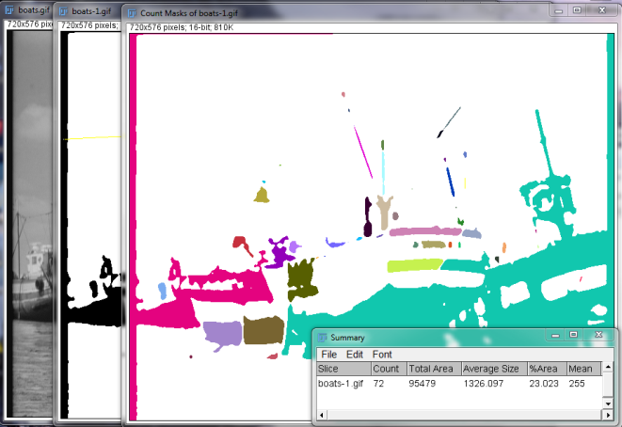
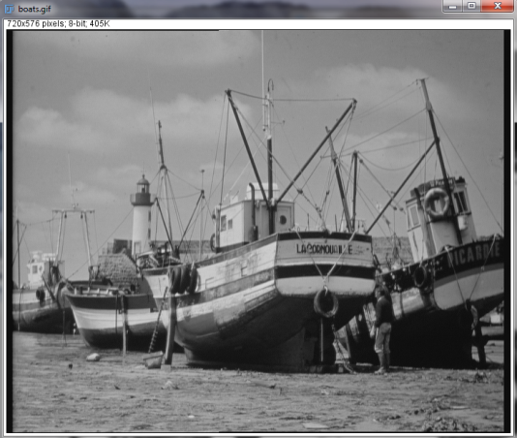
The Macro Recorder
Good to know:
A macro always acts on the active image.
Save your macro file.
Clean the code up.
Click Run to execute it.
Notes:
To run your macro:
Click “create” to open your recording in the script editor
Open a new image and run the macro
It works right away!
Each command processes the image in focus
In practice the image in focus is often the one that was created or modified by the previous command
Or the last one clicked before you run the macro

Slide 26
Demo/Hands-on: Macro Recorder
Macro recorder

Slide 27
Exercise 1: Macro Recorder
Exercise: Create a macro to segment the cells and measure them.
Part 1:
Open cells1.tif.
Open Macro recorder, optionally delete history.
Duplicate image cells1.tif and work on the duplicate (original image later needed for measurements).
Segment: Blurring, thresholding, binary watershed.
Set measurements: measure the mean and area, redirect to cells1.tif
Analyze particles (choose: ‘display results’, ‘count masks’)
Create the macro & save it.
Clean it up. Select window cells1.tif and rerun the macro. Does it work?
Part 2:
Close all the open image windows and tables.
Now open cells2.tif and run the macro. Does it work? What is the problem?
Solution: solution_segment_cells.ijm
Notes:
Q: what is annoying about the macro: it doesn‘t work on an image with a different name. In next sections we will see how to fix this!

Slide 28
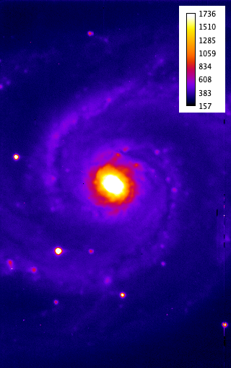
Exercise 2: Macro Recorder
Exercise: Create a macro to convert m51.tif to a PNG file with calibration bar
You have to add image m51.tif to a presentation.
Open m51.tif.
Open Macro recorder, optionally clear it.
Apply “Fire” LUT
Add a calibration bar.
Convert the image to an RGB-color type
Rename the image to m51_for_presentation
Save As png to your Desktop
Load it into the PowerPoint. Did it work?
Solution: solution_image_for_presentation.ijm

Slide 29

Troubleshooting
🖥
⚠️

Slide 30
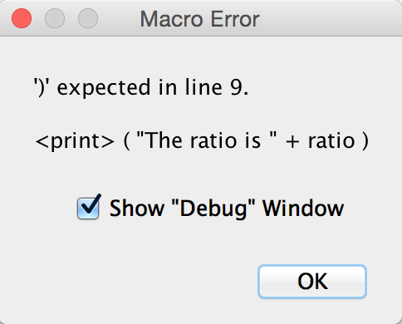
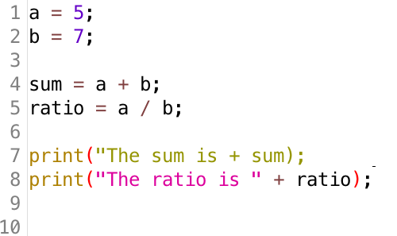
Troubleshooting
If your program throws error messages:
Don’t panic.
Read where the error happened.
Check the line number
Read what appears to be wrong.
Is something missing?
Check also lines above and below the error location
Don’t take error messages very strictly.
A program may have issues with another program.
Color highlighting
Check if color highlighting is consistent
Easy way to spot errors!

Slide 31
Demo/Hands-on: Troubleshooting
Let‘s correct some errors!
Exercise 0: Correct errors using code color highlighting
Open and run troubleshooting_with_code_highlights.ijm
Play close attention to the color highlighting!
Exercise 1: Correct errors via error messages
Open and run troubleshooting_error_message.ijm
Look at the error messages and fix the errors

Slide 32
Quiz 2
// initialise program
firstname = "Robert";
lastname = "Haase";
// run complicated algorithm
name = firstname + " " + lastname;
print("Hello " + name + "!");
Look at the code snippet
By looking at the colors in the code guess what element each of the following is
print
name
Robert
//initialize program
variable
command
string
comment

Slide 33
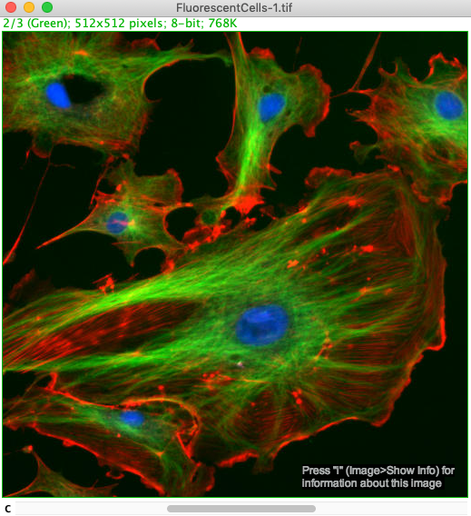
Working with Open Images

Slide 34
Basic Commands to Work with Images
IJ macro language provides numerous built-in commands to work with images
Get image name and select an image window
In Macro language images are identified by their title.
Rename an image
imageTitle = getTitle();
// do fancy processing here
...
// select original image again
selectWindow(imageTitle);
rename(“my new title”);
// or even like so
newTitle = “My new title”;
rename(newTitle);
Built-in command | Description | Parameters
imageTitle = getTitle(); | returns name of current image
selectWindow(imageTitle); | brings this image to the front | Name of window to be selected
rename(newTitle); | renames the image | New image title as a “string”

Slide 35
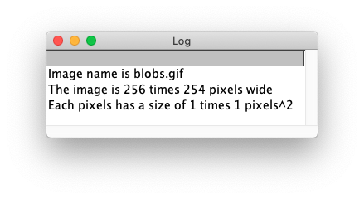
Basic Commands to Work with Images
Reading image properties
read_image_properties.ijm
imageName = getTitle();
// read image properties
width = getWidth();
height = getHeight();
getPixelSize(unit, pixelWidth, pixelHeight);
// show results
print(”Image name is " + imageName);
print("The image is " + width + " times " + height + " pixels wide");
print("Each pixels has a size of " + pixelWidth + " times " + pixelHeight + " " + unit + ”^2");
Built-in command | Description | Parameters
width = getWidth(); height = getHeight(); | return the width/height of the current image
getPixelSize(unit, pWidth, pHeight) | get size of a pixel | variables where physical unit, width and height will be stored
getVoxelSize(vWidth, vHeight, vDepth, unit) | get size of a voxel | variables where width, height, depth and physical unit will be stored

Slide 36
Navigating in a Multi-Dimensional Image
Stack in IJ macro language: 3D – 5D images
Built-in commands have pattern Stack.doSomething( );
Dimensions: xyc
E.g. applications:
Get the stack dimensions
Set the position in a stack
// get all dimensions
Stack.getDimensions(width, height, channels, slices, frames);
print("channels: " + channels + ", slices: " + slices + ", frames: " + frames );
// set the channel
Stack.setChannel(2);
// alternative: channel, slice, frame
Stack.setPosition(2,1,1);
stack_navigation.ijm
Built-in command | Description | Parameters
Stack.getDimensions(width, height, channels, slices, frames) | Returns all dimensions of the current image
Stack.getPosition(channel, slice, frame) | Returns the current position in the image
Stack.setChannel(channel) Stack.setSlice(slice) Stack.setFrame(frame) | Sets the channel or slice or frame in a stack | The channel or slice or frame to be activated
Stack.setPosition(channel, slice frame) | Sets the channel and slice and frame in a stack | The channel and slice and frame to be activated

Slide 37
Demo/ Hands-on: Read Image Statistics
Demo: Let’s look at an example macro to measure image statistics
// initialise program
imageTitle = getTitle();
// get image statistics
getStatistics(area, mean, min, max, std);
// show results
print(”Image name =" + imageTitle);
print("The grey value ranges from " + min + " to " + max + ". ");
print("It has an average of " + mean + " +- " + std + ". ");
close();
image_statistics..ijm

Slide 38
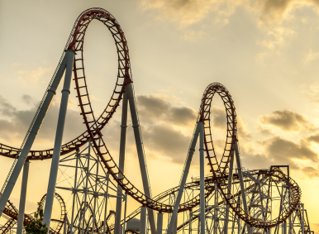
IJ Macro Advanced: Loops
photography from: https://excelmate.wordpress.com/tag/looping/

Slide 39
Loops
The for statement allows us to execute some lines of code for several times
Other ”loop” statements: while, do…while
Example applications of for loop:
Do same operation on each time frame of a time-lapse movie (measure mean)
Apply Gaussian blur on each slice of a z-stack
Process a folder of images (Part 2)
// do something
for( <initializer>; <condition>; <iterator>) {
// do something repeatedly
}
// do something
Note: this line does not end with a ; semicolon!

Slide 40
Loops
The for statement allows to execute some lines of code for several times
The initializer is only executed once; at the beginning.
1. start: initialize counter i
// do something
for( i = 0; i < 10; i++ ) {
// do something for 10 times
}

Slide 41
Loops
The for statement allows to execute some lines of code for several times
The initializer is only executed once; at the beginning.
The condition is checked every time before the whole block is executed.
2. check condition
If true code is executed
// do something
for( i = 0; i < 10; i++ ) {
// do something for 10 times
}

Slide 42
Loops
The for statement allows to execute some lines of code for several times
The initializer is only executed once; at the beginning.
The condition is checked every time before the whole block is executed.
After block execution, the counter is increased.
3. increase counter
// do something
for( i = 0; i < 10; i++ ) {
// do something for 10 times
}

Slide 43
Loops
The for statement allows to execute some lines of code for several times
The initializer is only executed once; at the beginning.
The condition is checked every time before the whole block is executed.
After block execution, the counter is increased.
2. check condition
If true: code is executed
// do something once
for( i = 0; i < 10; i++ ) {
// do something for 10 times
}

Slide 44
Loops
The for statement allows to execute some lines of code for several times
The initializer is only executed once; at the beginning.
The condition is checked every time before the whole block is executed.
After block execution, the counter is increased.
// do something once
for( i = 0; i < 10; i++ ) {
// do something for 10 times
}

Slide 45
Loops
The for statement allows to execute some lines of code for several times
The initializer is only executed once; at the beginning.
The condition is checked every time before the whole block is jumped over.
After block execution, the counter is increased.
2. check condition
If false: exit the loop
// do something once
for( i = 0; i < 10; i++ ) {
// do something for 10 times
}

Slide 46
Loops
The for statement allows to execute some lines of code for several times
The initializer is only executed once; at the beginning.
The condition is checked every time
After block execution, the counter is increased.
// do something once
for( i = 0; i < 10; i++ ) {
// do something at each
// iteration of the loop
}
// do another thing
The counter is initialized
check condition:
if true: execution code in the loop
if false: exit the loop
increase counter
Step 2 and 3 are repeated until the condition is false and the loop exits

Slide 47
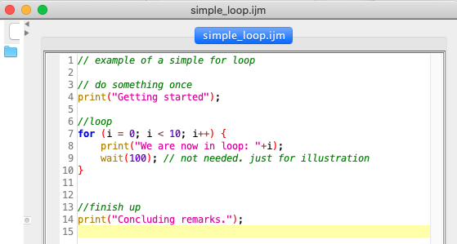
Hands-on/Demo: Loops
Let’s look at a simple loop implementation.
Open simple_loop.ijm and run it.
How many lines are printed as output within the loop?
simple_loop.ijm

Slide 48
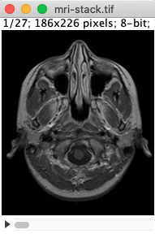
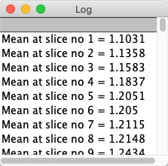
Exercise: For Loop
Exercise: Measure statistics and print mean intensity of each slice of a stack.
Open mri-stack.tif.
Get the total number of slices in the open image
Use Stack.getDimensions
Use for loop to go through each slice.
Hint: Stack.setSlice(n) is used to set position to a slice number
Measure statistics
Hint: take inspiration from image_statistics.ijm
Print mean at each slice.
Tips:
Have a look at exercise_template_stack_measurement_with_loop.ijm for help.
Use macro-recorder if you are not sure of a command.
Solution: solution_stack_measurement_with_loop.ijm

Slide 49
Customizing a Macro
⚙️🛠

Slide 50
Customize A Macro
A good macro has to be:
Generic: Adapt to different datasets
Adjustable: Use variable to hold values not known at start
Dynamic: Allow for variables to be computed on-the-fly
Examples:
Process an image with an arbitrary name.
Save an image or table with a custom name.
Filter an image according to some user input (for example blurring strength).
🍎🍏🍊🍑
︸
Fruit

Slide 51
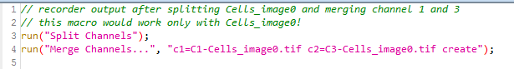
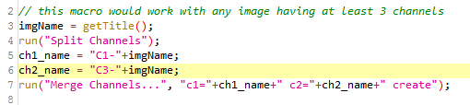
Customize Command Parameters
Recorder output
Updated macro
Notes:
Image segmentation macro worked fine from the recorder without any modification
Unfortunately that is not always the case

Slide 52
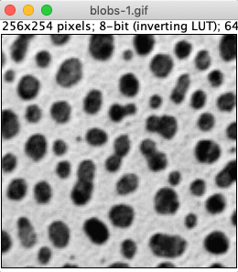




Customize command parameters
Example: User specifies custom processing parameters.
custom_parameters.ijm
Question: why is it useful to have these flexible parameters at the beginning of the script?
Notes:
Question: why is it useful to have these parameters at the beginning of the script?
-> Much easier to find. It is clear which parameters are intended to be changed. They can as next step be made into a GUI

Slide 53

Hands-on/Demo: Customize macro
Start with the macro demo_customize_macro.ijm
Activity 1: Vary the value of sigma for Gaussian blur and see the results.
Activity 2: Now, define a variable “sigma” which will hold the value for blurring strength. Modify the function. Change the value here and run the macro.
What is easier? Activity 1 or Activity 2? Why?
Solution: solution_demo_customize_macro.ijm

Slide 54

Exercises: Making Macros more Generic
Exercise: Segment an image, make it usable for other images.
Start from the macro exercise_segment_cells_input_for_generalization.ijm.
Read it and make sure you understand what’s happening.
Open cells1.tiff and run it the macro.
Close cells1.tif and other images, tables.
Make the macro generic:
Use getTitle() to get the image name into a variable.
Replace all occurrences of the name with the generic title.
Run the macro on cells2.tif.
Does it work?
Tips:
If you don’t know a command, try to record it.
Solution: solution_segment_cells_generalized.ijm

Slide 55

Exercises: Making Macros more Generic
Exercise 2: Multichannel image and LUTs
Goal: Macro that loads an image with 3 channels, splits the channels, changes the LUTs, then merges two of the channels.
Steps:
Open the image Cell_image0.tif
Split the channels.
Select the image with channel 1:
Change the LUT to magenta + enhance the contrast
Select the image with channel 3:
Change the LUT to cyan + enhance the contrast.
Merge channels 1 and 3 (create a composite)
Convert in into an RGB image.
Give a new name to the image.
Now create the macro, clean it up and make it general.
The macro should work for any 3-channeled image
Hint: Use getTitle() as before to get image name into a variable.
Run the macro on Cell_image1.tif: Does it work?
Tips:
Use the macro recorder to get a first macro, then clean it up and make it generic.
Susanne Hasse, Transgenomic Facility, MPI-CBG, 2015
Comment:
When changing a LUT think about whether the new color makes sense or is misleading.
Red -> Magenta is definitely recommended (better visibility for color blind people).
Solution: solution_multichannel_image_luts.ijm

Slide 56

Good Practices

Slide 57

Good Practices for Reproducible Results
Write macros.
This is the base for any reproducibility and comparability (for example between main experiment and control).
Write comments.
Overview:
What does the macro do?
Usage? For which image type?
Author, contact?
Write also comments within the code:
What do these steps do?
Your colleagues and your future self will thank you!
Keep track of:
The original image name used to obtain a measure
The analysis parameters

Slide 58



Good Practices for Reproducible Results
A = w * h;
print( A );
Write readable code:
Write comments.
Give variables meaningful names.
Use spaces between operators and operands.
Every command on its own line.
Use empty lines to separate important parts.
Keep it short and simple (KISS).
Write the code as clear and simple as possible, so that it is easy to read and maintain.
area = width * height;
print( area );
// initialise program
a = 5;
b = 3;
c = 8;
// execute algorithm
d = (a + b) / c;
// evaluate result

Slide 59
Summary
Macro basics
Macro recorder
Macro for Images
Good practices
imageTitle = getTitle();
// do fancy processing here
...
// select original image again
selectWindow(imageTitle);
A = w * h;
print( A );
Built-in command
Stack.getDimensions(width, height, channels, slices, frames)
Stack.getPosition(channel, slice, frame)
area = width * height;
print( area );

